Slide 1
EASYWALK [SMART CANE FOR VISUALLY IMPAIRED]
SDG 03: Good Health and Well-being- This innovative tool not only promotes physical well-being by enhancing safety but also fosters mental health by instilling confidence and independence in navigating daily surroundings.
TEAM MEMBERS:
ARCHANA G - 211420104022
ANUDHARSHNI M P - 211420104020
BRINDHA C S - 211420104044
BATCH: A3
GUIDE: DR. SANGEETHA KALYANIRAMAN
DOMAIN: INTERNET OF THINGS

Slide 2
ABSTRACT
In the contemporary world, the prevalence of visual impairment has reached alarming proportions. According to the World Health Organization (WHO), the global estimate stands at a staggering 2.2 billion individuals afflicted with vision impairment, and regrettably, the availability of constant assistance remains an elusive prospect. Simple activities such as crossing a street or moving around unfamiliar places can be daunting.
In order to assist those who are blind or visually impaired in their daily lives without the assistance of others, the smart stick has been offered as a solution. The Smart Stick is a cutting-edge assistive device designed to enhance the mobility and safety of visually impaired individuals.
Equipped with advanced sensors, the Smart Stick employs a multifaceted approach to alert users of potential obstacles, holes, and water bodies in their path. When the user clicks the emergency button it sends an SOS alert message to emergency registered contact with live location tracking. This initiative transcends the realm of technology; it embodies a lifeline to independence and security.

Slide 3
LITERATURE REVIEW
SURVEY 1:
Title: Design of Smart Cane with integrated camera module for visually impaired people
Authors: Lavanya Narayani. T et al.
Methodology: The cane employs a pair of ultrasonic sensors to identify obstructions and sounds a warning when they approach a 2-meter range. Additionally, it has an ESP-32 camera module for capturing images and gathering situational data.
Advantages: It saves processor time and it is affordable.
Limitations: The integration of multiple sensors, increase the complexity of the smart cane. It consumes more power because of camera.

Slide 4
SURVEY 2:
Title: Computer Vision and Iot Based Smart System for Visually Impaired People
Authors: Sneha Rao et al.
Methodology: It uses a shoe-based assistance system using IoT devices, sensors, and computer vision algorithms for obstacle detection, avoidance, and navigation utilizing smartphone-based voice assistance and haptic feedback.
Advantages: It makes use of voice assistance to guide the blind.
Limitations: It is not useful for the person who are both blind and handicapped.

Slide 5
SURVEY 3:
Title: Smart blind helping stick using Iot and android
Authors: Srishti Agrawal et al.
Methodology: It uses an Arduino board module and Android application to assist blind individuals in making decisions, identifying obstacles, providing audio alarms, and acting as a DC buzzer.
Advantages: It provide audio alarms, and act as a DC buzzer in the event that Bluetooth fails.
Limitations: It lacks emergency button, limiting immediate response capability in critical situations for visually impaired individuals.

Slide 6
SURVEY 4:
Title: Smart Blind Stick for Visually Impaired People using IoT
Authors: Rajanish Kumar Kaushal et al.
Methodology: It uses an ultrasonic sensor, ESP32 camera, and Artificial Neural Network model to detect potential obstructions and traffic signals.
Advantages: It uses ANN to recognize traffic signal.
Limitations: Absence of rain sensor in smart cane limits its ability to detect and navigate through wet conditions accurately.

Slide 7
SURVEY 5:
Title: Smart blind stick
Authors: Prashik Chavan et al.
Methodology: A smart stick uses an ultrasonic sensor to identify obstacles in two scenarios: In case 1, the stick identifies the obstacle in front using an ultrasonic sensor, but in case 2, the servo motor turns the ultrasonic sensor via an angle to identify the impediment in a congested area. The switch button moves between scenarios, allowing for easy identification of obstructions.
Advantages: It identifies the obstacles through rotation.
Limitations: As it was limited by one sensor, the smart cane's functionality is restricted, potentially hindering its effectiveness and versatility for users.

Slide 8
PROBLEM STATEMENT
Traditional white canes, while valuable tools for the visually impaired, exhibit inherent inefficiencies that compromise effective navigation.
The current smart cane design faces challenges due to the integration of multiple sensors, leading to increased complexity, power consumption, and limitations in obstacle detection.
They cannot warn users of impending dangers or provide insights into changes in terrain, making navigation more challenging and potentially risky.
It lacks features to distinguish obstacles, detect water bodies, and accommodates blind and handicapped individuals. The absence of an emergency button and rain sensor also compromises safety.

Slide 9
EXISTING SYSTEM
Indoors, traditional canes are less effective at identifying smaller obstacles and furniture, presenting challenges for users navigating indoor spaces.
The range of detection for traditional canes is confined to the cane's physical reach, limiting users' ability to anticipate obstacles beyond their immediate vicinity.
Blind sticks that incorporate cameras relying on visual information may encounter limitations in low-light conditions or complete darkness, presenting challenges for users navigating environments with inadequate lighting.

Slide 10
PROPOSED SYSTEM
The Smart Stick is a revolutionary tool designed to assist visually impaired individuals by providing obstacle detection, and enhanced navigation support.
It uses advanced technology, including ultrasonic and raindrop sensors, to scan surroundings and identify obstacles. These sticks offer location-sharing capabilities during emergencies, ensuring timely assistance from caregivers or emergency services.
It also uses wireless communication technologies for precise location tracking and seamless connectivity to a smartphone app.
The fluorescent covering enables night vision, so that it ensures safe navigation even in low-light conditions.

Slide 11
TECHNOLOGY STACK
HARDWARE
REQUIREMENTS:
SOFTWARE REQUIREMENTS:
Ultrasonic sensor
GPS Neo
Push button
Raindrop sensor
Fluorescent tape
Buzzer
Arduino IDE
Programming language: Embedded C
MQTT server
Frontend : ReactJS

Slide 12
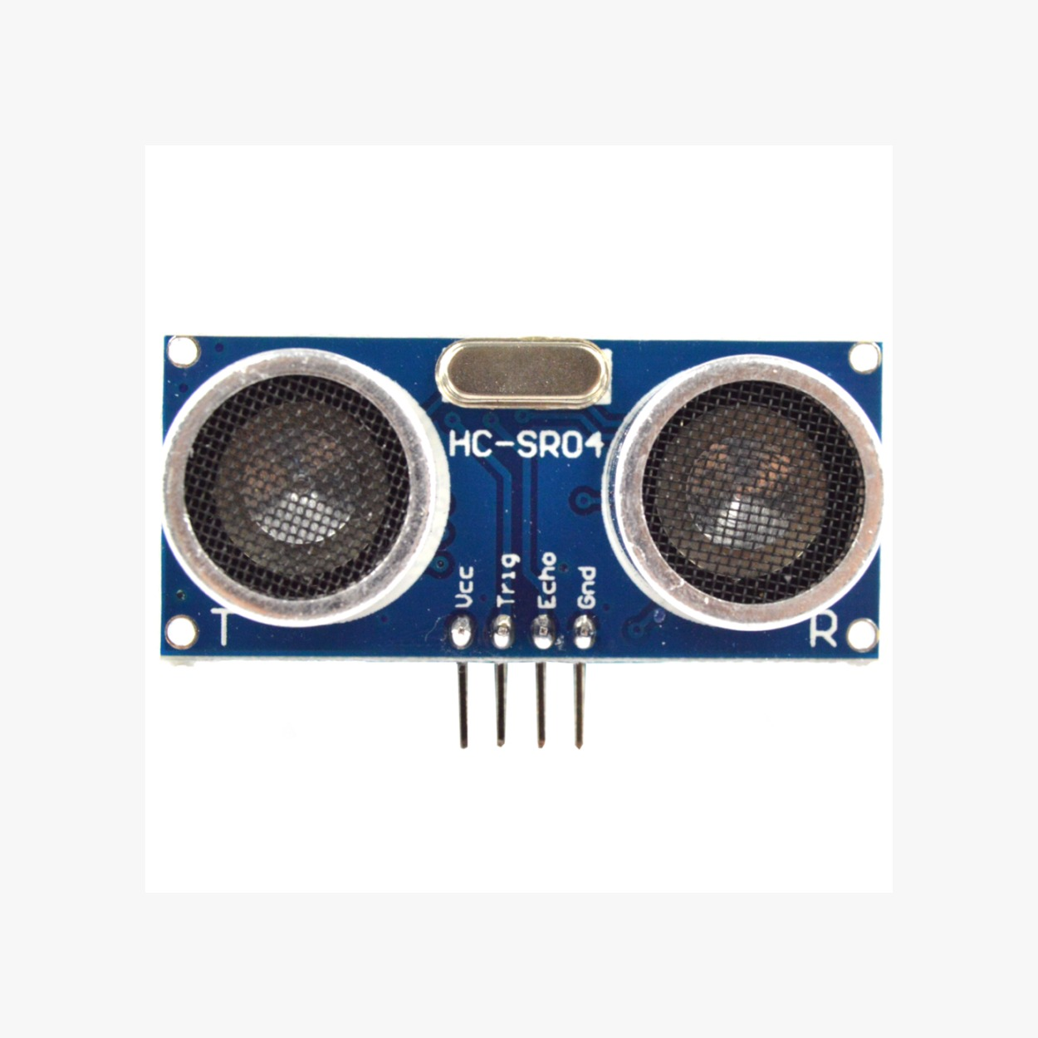
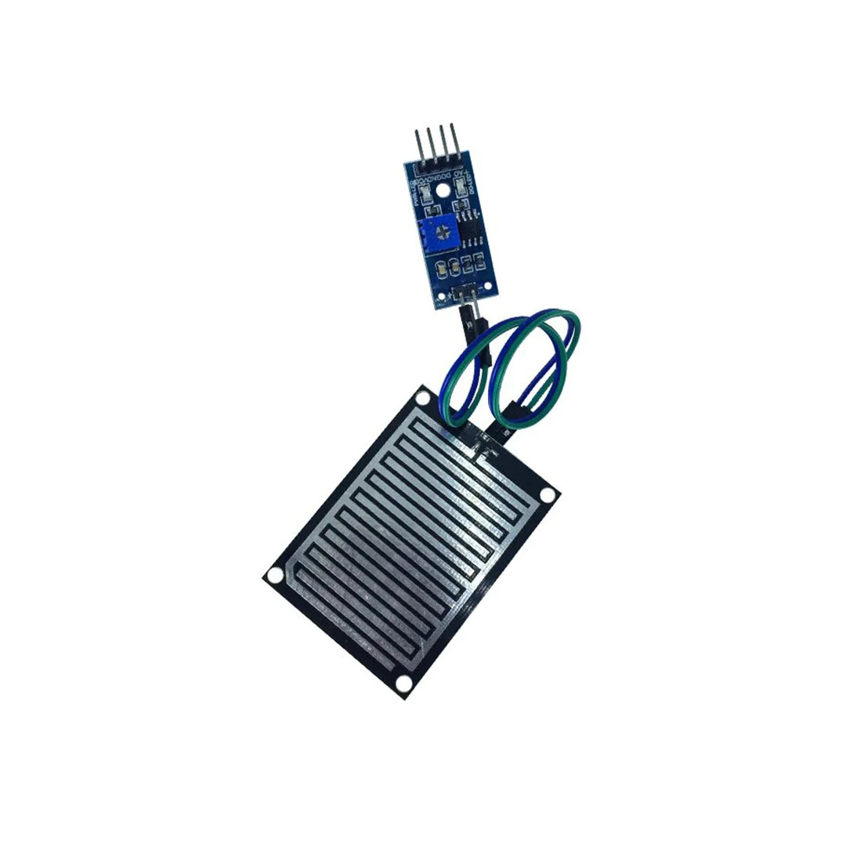
DESIGN SPECIFICATIONS
ULTRASONIC SENSOR
An ultrasonic sensor emits high-frequency sound waves, measuring bounce-back time to detect obstacles.
For obstacle detection, one HC-SR04 sensor (20cm range) is used.
For pothole detection, two sensors (10cm and 15cm ranges) are deployed, scanning the ground ahead. Comparing readings allows identification of potholes or uneven terrain. Short-range sensor detects smaller potholes, while longer-range sensor detects larger ones.
RAIN SENSOR
A rain sensor is a device designed to detect the presence of rain or moisture.
It detects rainfall by measuring conductivity changes when raindrops bridge conductive elements. This provides weather feedback, enabling users to take necessary precautions.

Slide 13
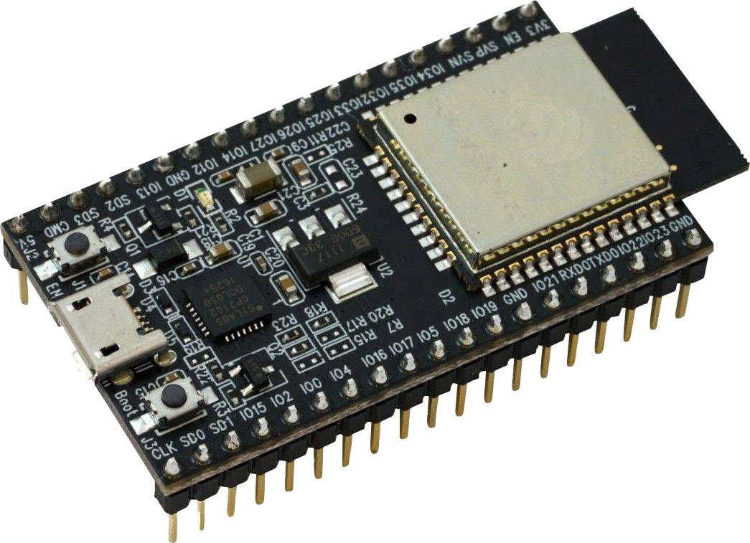
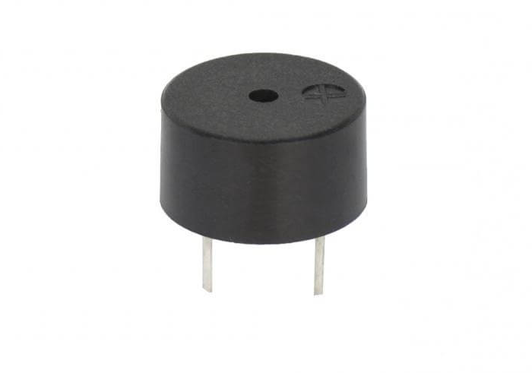
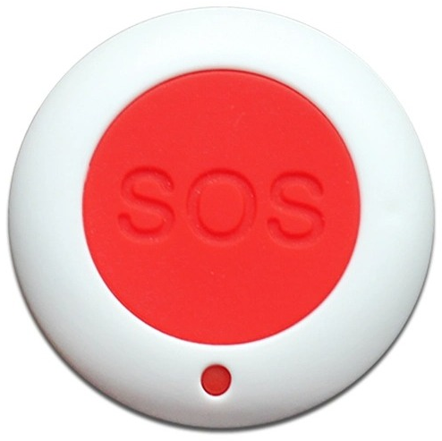
ESP32 MICROCONTROLLER
The ESP32 microcontroller, prized for versatility and affordability, boasts dual-core processing, Wi-Fi, and Bluetooth.
It prioritizes energy efficiency, catering to IoT needs with low power consumption while offering seamless connectivity options for diverse applications.
BUZZER
A buzzer is a small electronic device that produces a buzzing or beeping sound when an electrical signal is applied to it.
It alerts the user if they approaches a obstacle.
SOS BUTTON
Upon physical activation, the emergency SOS button triggers an alert signal and employs built-in location services like GPS to ascertain the user's precise coordinates.
It promptly transmits this information along with the emergency alert to designated recipients.

Slide 14
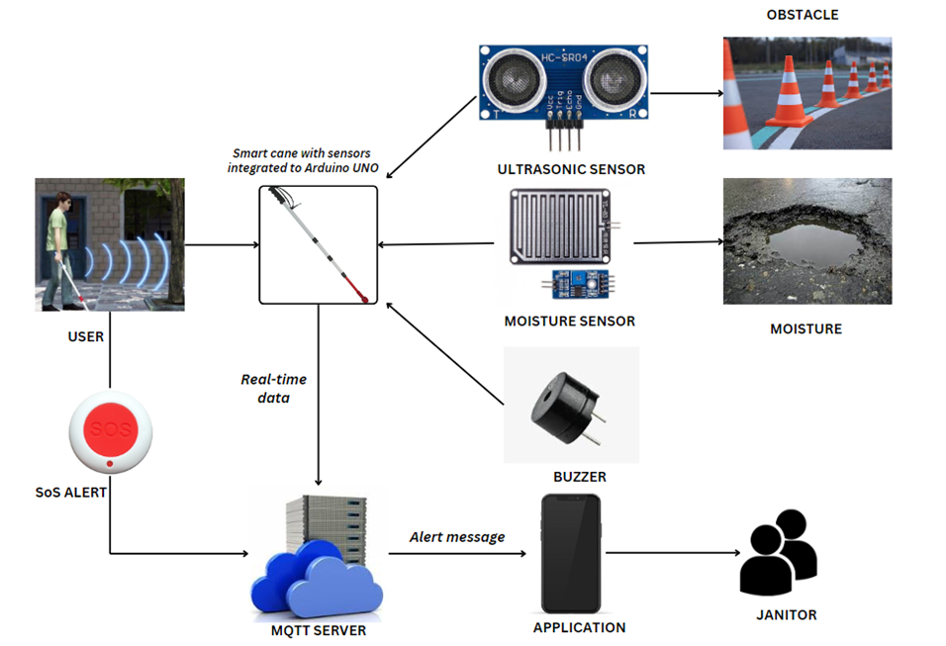
ARCHITECTURE DIAGRAM

Slide 15
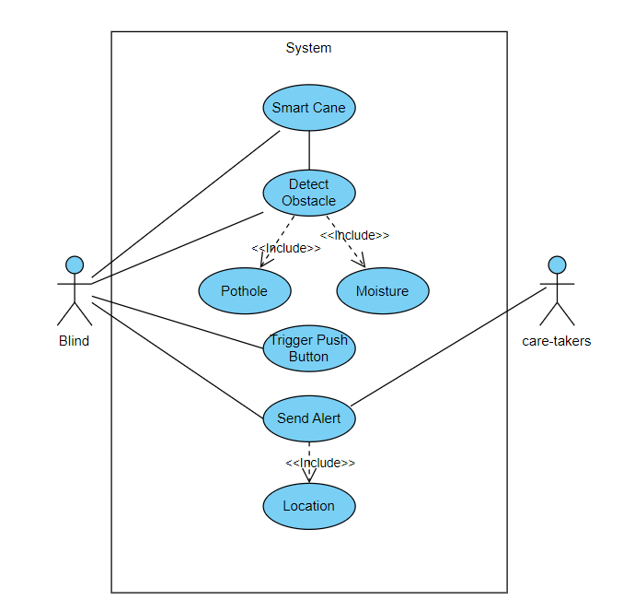
UML DIAGRAMS
USECASE DIAGRAM

Slide 16
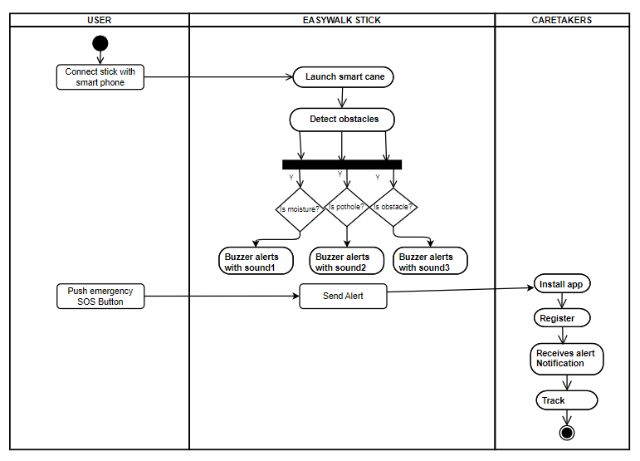
ACTIVITY DIAGRAM

Slide 17
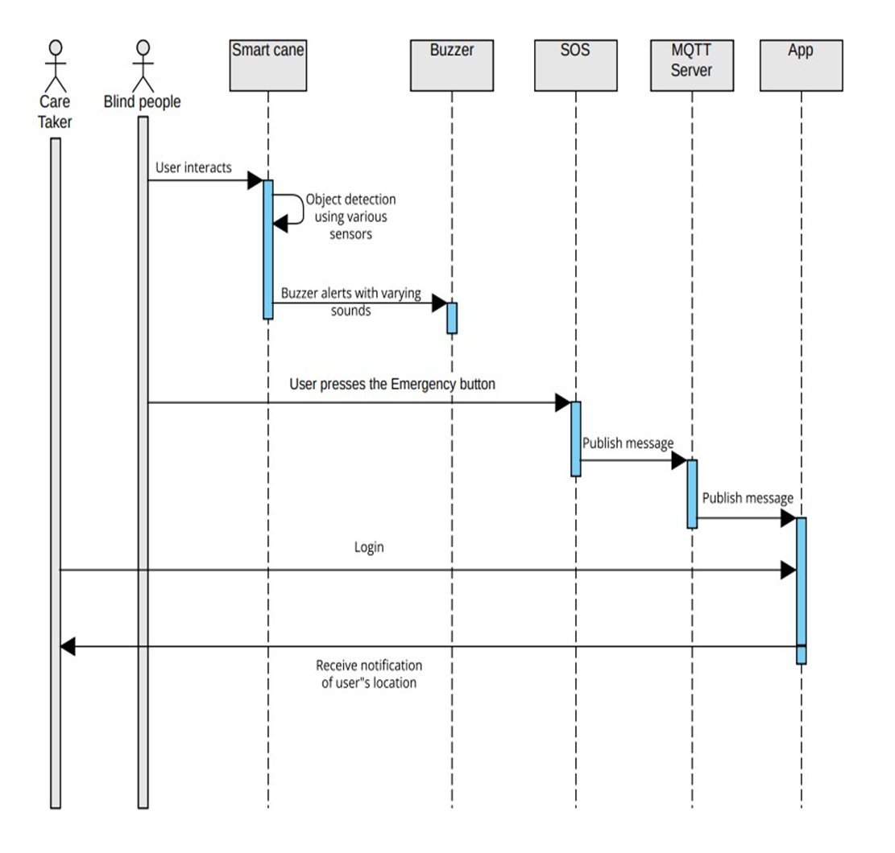
SEQUENCE DIAGRAM

Slide 18
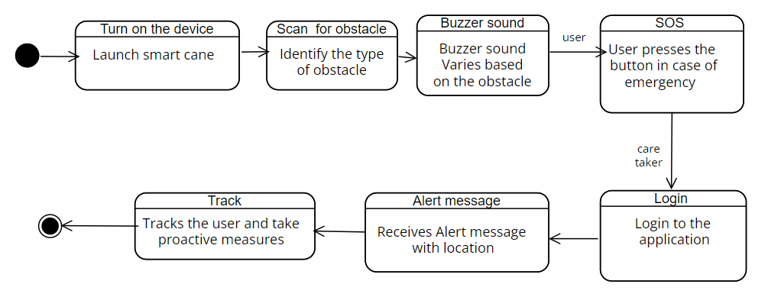
STATECHART DIAGRAM

Slide 19
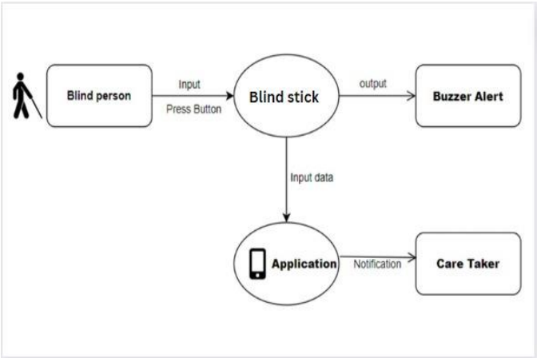
DATAFLOW DIAGRAM
DFD LEVEL 0

Slide 20
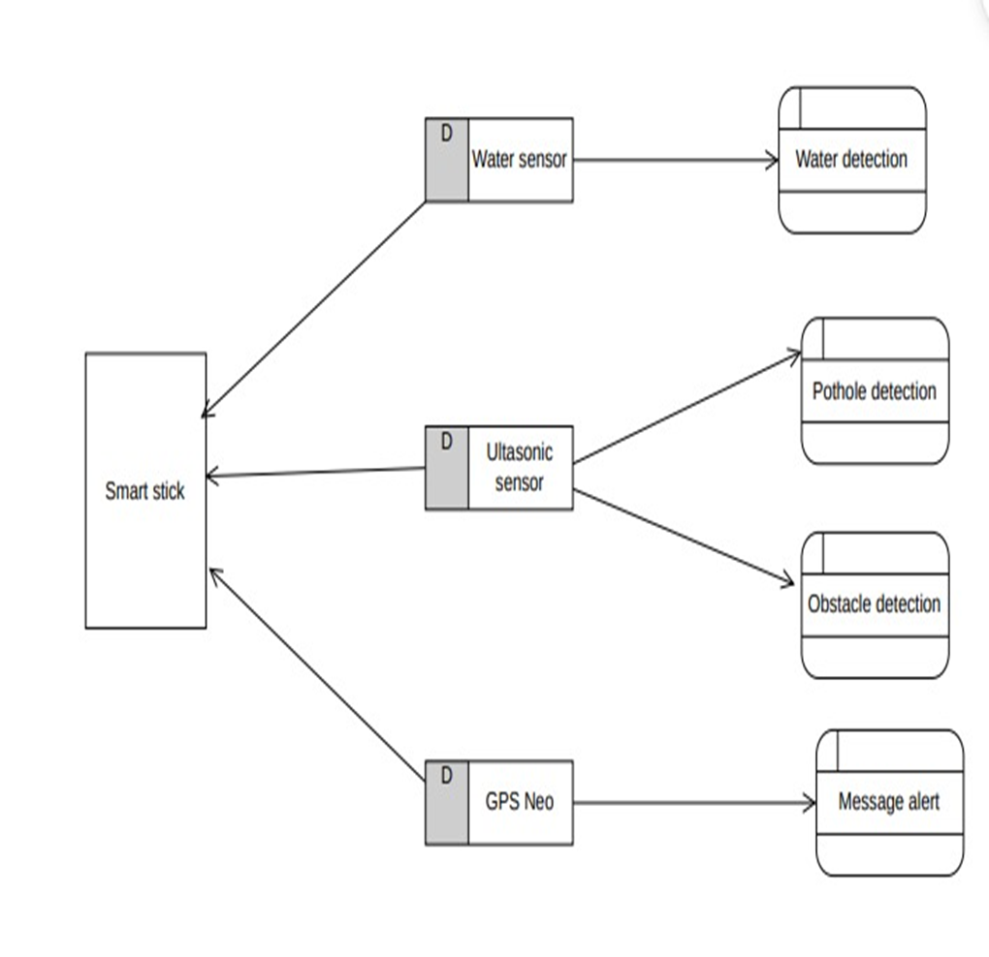
DATAFLOW DIAGRAM
DFD LEVEL 1

Slide 21
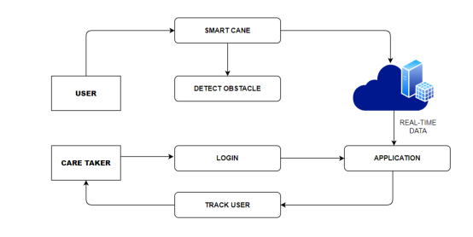
DATAFLOW DIAGRAM
DFD LEVEL 2

Slide 22
MODULE DESCRIPTION
OBSTACLE DETECTION: The system activates a buzzer warning signal upon detecting obstacles within a predefined range, enabling users to promptly navigate around them, thereby reducing collision risks.
MOISTURE DETECTION: The moisture detection feature, strategically placed near its tip, helps prevent slipping hazards in adverse weather conditions. The system alerts users, enabling proactive measures and enhancing safety, especially in outdoor environments.
POTHOLE DETECTION:The Smart Cane's pothole detection feature utilizes strategically positioned ultrasonic sensors to enhance user safety by continuously scanning for surface irregularities and identifying potential hazards.
EMERGENCY ALERT : The smart blind stick uses an alert system to detect critical situations and track the user's real-time location. When an emergency trigger is activated, the system generates an alert message, which is then transmitted to caregivers or emergency contacts for prompt assistance.

Slide 23
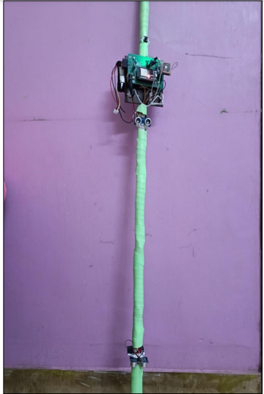
SMART CANE SETUP

Slide 24
TEST CASES AND REPORTS
TEST CASE ID | TEST CASE | EXPECTED RESULT | ACTUAL RESULT | PASS/FAIL
TC01 | Place the smart cane in an open area without obstacles | Smart cane indicates no obstacles detected with no buzzer alert | No obstacles detected with no buzzer alert | Pass
TC02 | Place the smart cane in a narrow corridor or obstructed area | Cane provides appropriate alerts or feedback with buzzer alert | Obstacles detected with buzzer alert | Pass
TC03 | Test the rain sensor in a dry environment | No moisture detected with no buzzer alert | No moisture detected with no buzzer alert | Pass
TC04 | Expose the rain sensor to water or simulate rain | Smart cane detects rain with buzzer alert | Smart cane detects rain with buzzer alert | Pass

Slide 25
TEST CASES AND REPORTS
TEST CASE ID | TEST CASE | EXPECTED RESULT | ACTUAL RESULT | PASS/FAIL
TC05 | Place the smart cane on a flat, even surface | No buzzer alerts indicating potholes | No buzzer alerts indicating potholes | Pass
TC06 | Place the smart cane on a surface with small potholes or uneven terrain | Cane provides buzzer alerts for detected potholes | Cane provides buzzer alerts for detected potholes | Pass
TC07 | Before user presses the SOS button | Displays No Blind SOS Detected message | Displays “No Blind SOS Detected message” | Pass
TC08 | After the user presses the SOS button | Displays Alert message with location URL to track the user | Displays Alert message with location URL to track the user | Pass

Slide 26
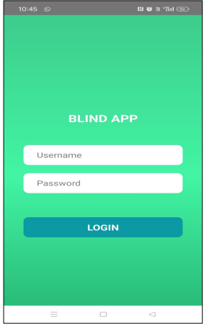
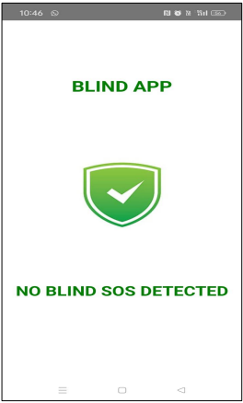
OUTPUT SCREENSHOTS
LOGIN PAGE
BEFORE SOS ALERT

Slide 27
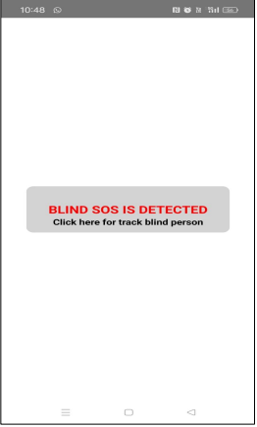
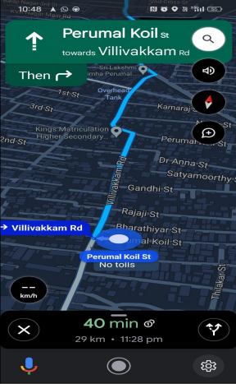
EMERGENCY ALERT PAGE
TRACKING PAGE

Slide 28
CONCLUSION
The discussion on our smart stick design underscores the necessity of enhancing safety measures for visually impaired individuals during travel, whether in familiar or unfamiliar surroundings.
The development of our proposed smart cane with obstacle detection, moisture detection, pothole detection, and emergency SOS services represents a significant contribution to the field of assistive technology for visually impaired individuals.
By integrating advanced sensors and real-time communication capabilities, our smart cane offers a comprehensive solution to enhance mobility, safety, and independence.

Slide 29
FUTURE ENHANCEMENT
Implementing AI algorithms can enhance the smart cane's capabilities, such as more advanced obstacle recognition, intelligent route planning, and personalized assistance based on user preferences and behavior patterns.
Anticipate more sophisticated obstacle detection capabilities, leveraging cutting-edge technologies such as LiDAR and advanced computer vision algorithms.
It can also integrate with emerging technologies like 5G networks and Internet of Things (IoT) devices can improve real-time communication, data transmission, and remote monitoring features, enhancing the overall user experience.

Slide 30
BASE PAPER LINK
https://ieeexplore.ieee.org/document/9395840

Slide 31
THANK YOU!!

